Slide 1








VORTEXA
3.0
12 HRS HACKATHON
POWERED BY A.I.R.S
DOMAIN & NO : 3, B-02
PROBLEM STATEMENT TITLE :
Insure Chain: Policy-Aware Insurance Claims Workflow
TEAM NAME : Midnight Sons
TEAM ID : JER 4755393

Slide 2

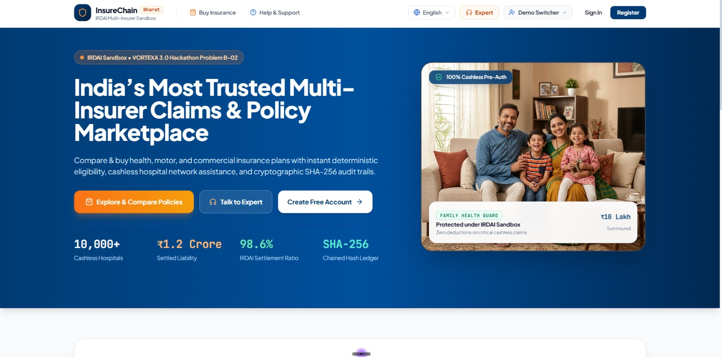

PROBLEM STATEMENT
Insurance claims require multiple rules to be checked together, but manual processing can lead to inconsistent decisions and weak accountability.
Key Challenges
Claims may be approved despite missed filing deadlines or excluded categories.
The same incident may be submitted under different claim references and paid twice.
Unauthorized users may approve claims or bypass required workflow stages.
Historical decisions may be difficult to verify if records are altered.
Claim narratives may contradict structured data and require human review.
Our Objective
Build a policy-aware claims workflow that applies explicit rules, prevents duplicate incidents from being paid twice, enforces authorized state transitions, and preserves verifiable decision history.

Slide 3
IDEA TITLE / PROPOSED SOLUTION
A policy-aware insurance claims workflow that combines deterministic policy checks, controlled approvals, duplicate-incident prevention, and a cryptographically verifiable audit trail.
Core Capabilities
Policy Rule Engine — Checks filing deadlines, excluded categories, and coverage limits with clear decision reasons.
Duplicate Guard — Detects claims linked to the same incident under the same policy, even when claim references differ.
Role-Based Workflow — Enforces permitted state transitions and role-specific authorization.
Verifiable Audit Trail — Records accepted decisions and refusals, with integrity verification.
AI-Assisted Review — Flags possible narrative inconsistencies for human review without changing eligibility or claim status.
Design Principle: Transparent rules. Controlled decisions. Traceable actions.

Slide 4
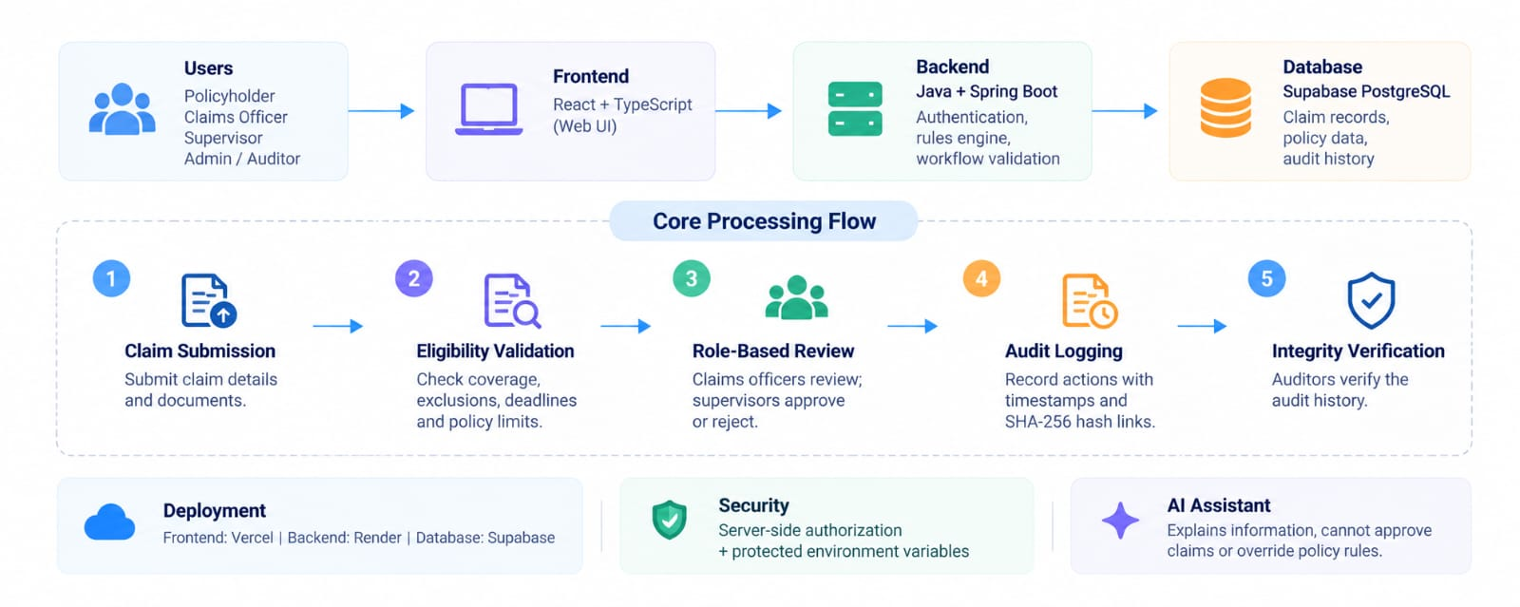
TECHNICAL APPROACH
Core Workflow
Claim Submission: Details and documents uploaded.
Eligibility Check: Coverage, exclusions, deadlines and limits validated.
Role-Based Review: Officers review; supervisors approve or reject.
Audit Logging: Timestamped actions linked using SHA-256 hashes.
Integrity Verification: Auditors verify audit history.
Deployment & Security
Hosting: Vercel (frontend), Render (backend), Supabase (database).
Security: Server-side authorization, protected secrets and validated workflows.
AI Assistant: Explains verified information but cannot approve claims or override policy rules.

Slide 5
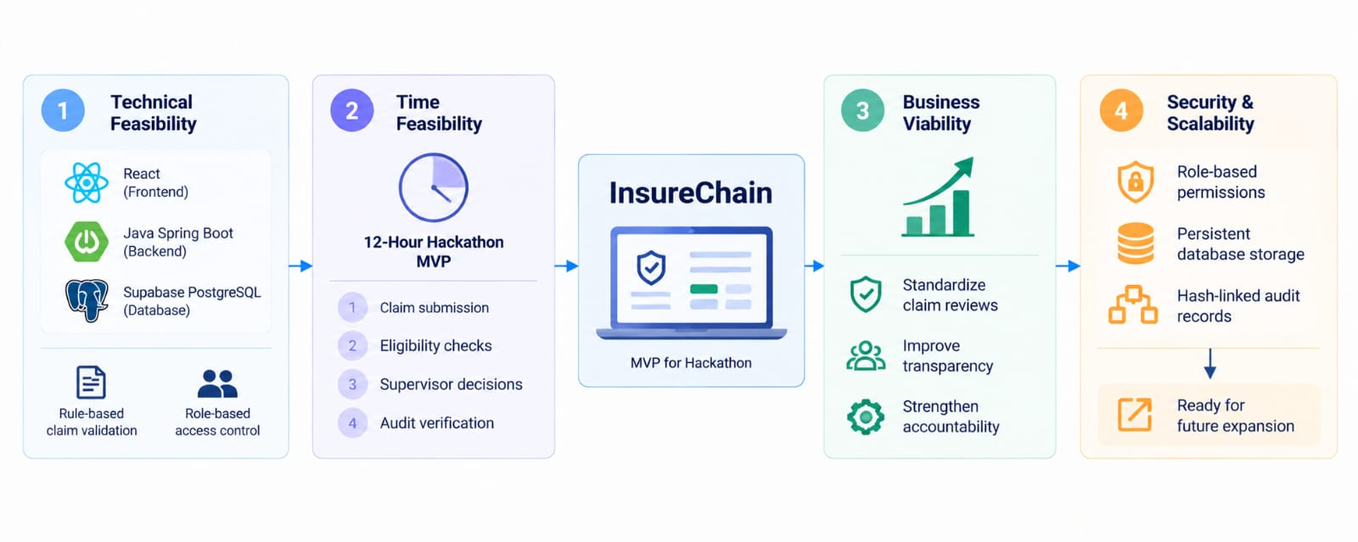
FEASIBILITY AND VIABILITY
InsureChain is feasible to develop as a hackathon prototype using existing web technologies and a modular architecture.
1. Technical Feasibility
Built using React, Java Spring Boot and Supabase PostgreSQL, with rule-based claim validation and role-based access control.
2. Time Feasibility
A focused MVP can prioritize claim submission, eligibility checks, supervisor decisions and audit verification within the 12-hour hackathon.
3. Business Viability
Can help insurers standardize claim reviews, improve transparency and strengthen accountability.
4. Security and Scalability
Role-based permissions, persistent database storage and hash-linked audit records provide a foundation for future expansion.

Slide 6
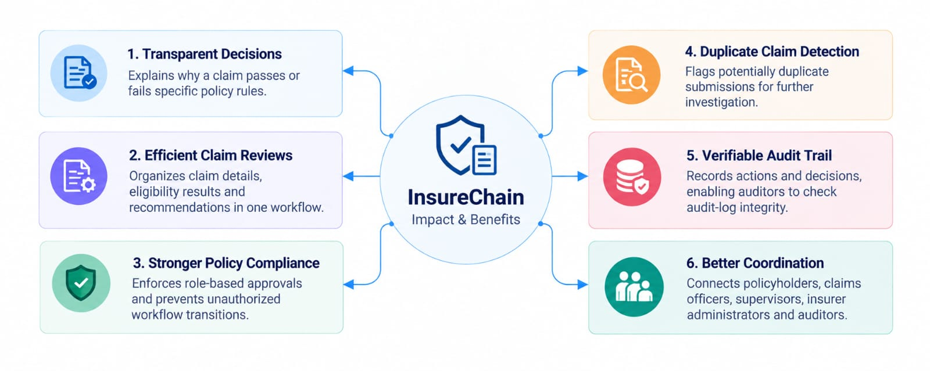
IMPACT AND BENEFITS
InsureChain improves transparency, accountability and trust in insurance claim processing through policy-aware validation and secure workflow management.
1. Transparent Decisions
Explains why a claim passes or fails specific policy rules.
2. Efficient Claim Reviews
Organizes claim details, eligibility results and recommendations in one workflow.
3. Stronger Policy Compliance
Enforces role-based approvals and prevents unauthorized workflow transitions.
4. Duplicate Claim Detection
Flags potentially duplicate submissions for further investigation.
5. Verifiable Audit Trail
Records actions and decisions, enabling auditors to check audit-log integrity.
6. Better Coordination
Connects policyholders, claims officers, supervisors, insurer administrators and auditors.

Slide 7
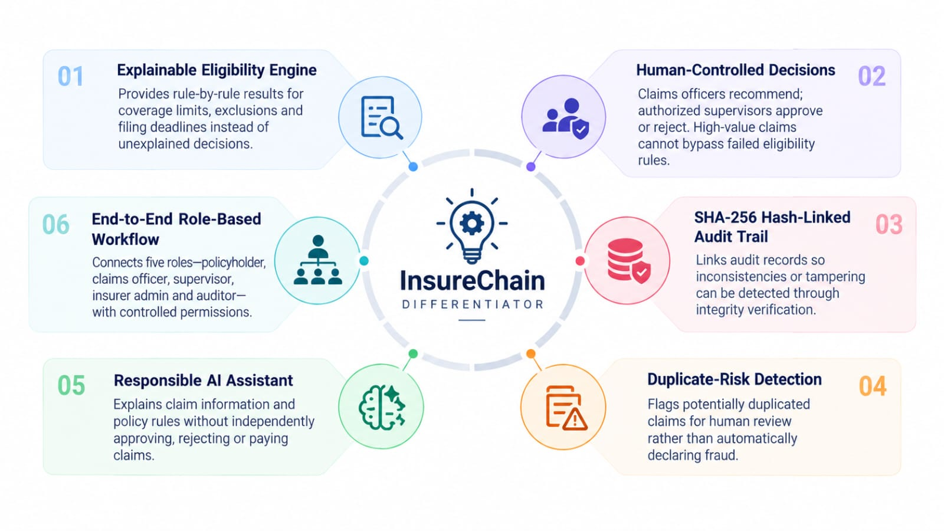
DIFFERENTIATOR
InsureChain stands out by combining explainable policy rules, human-controlled approvals and cryptographically verifiable audit records in one insurance claims workflow.
1. Explainable Eligibility Engine
Provides rule-by-rule results for coverage limits, exclusions and filing deadlines instead of unexplained decisions.
2. Human-Controlled Decisions
Claims officers recommend; authorized supervisors approve or reject. High-value claims cannot bypass failed eligibility rules.
3. SHA-256 Hash-Linked Audit Trail
Links audit records so inconsistencies or tampering can be detected through integrity verification.
4. Duplicate-Risk Detection
Flags potentially duplicated claims for human review rather than automatically declaring fraud.
5. Responsible AI Assistant
Explains claim information and policy rules without independently approving, rejecting or paying claims.
6. End-to-End Role-Based Workflow
Connects five roles—policyholder, claims officer, supervisor, insurer admin and auditor—with controlled permissions.

Slide 8










THANK YOU!
Game’s
Still On
VORTEXA 3.0
AIRS

